Slide 1
When to buy and sell stocks?
DS501 Case 2 Group 5
Jack Charbonneau, Jannik Hass, Weixiao Huang, Ye Hong

Slide 2
We are interested in this problem:
What is the best time to buy or sell stocks?

Slide 3
Approach One
Considering Momentum effect
Measure the 100-day trailing returns of a basket of stocks;
Find those positive trailing returns, then rank those stocks based upon trailing returns of stocks;
If the top n (e.g. n = 3) stocks whose monthly price >= 200-day simple moving average, buy;
Else, hold.
Notes:
Weixiao

Slide 4





Case study: data period is from 2016/10/20 to 2019/10/20
Notes:
Weixiao

Slide 5



Top 3 ranking results based upon 100-day trailing returns
Notes:
Weixiao

Slide 6
Is 2019/10/20 a good timing to buy?
Let us check monthly price >= 200-day simple moving average. If yes, buy.
BUY
HOLD
$
$
$
$
$
$
$
$
$
$
$
$
$
$
$
$
$
$
$

Slide 7
Is 2019/10/20 a good timing to buy?
Let us check monthly price >= 200-day simple moving average. If yes, buy.
BUY
HOLD
BUY
$
$
$
$
$
$
$
$
$
$
$
$
$
$
$
$
$
$
$

Slide 8
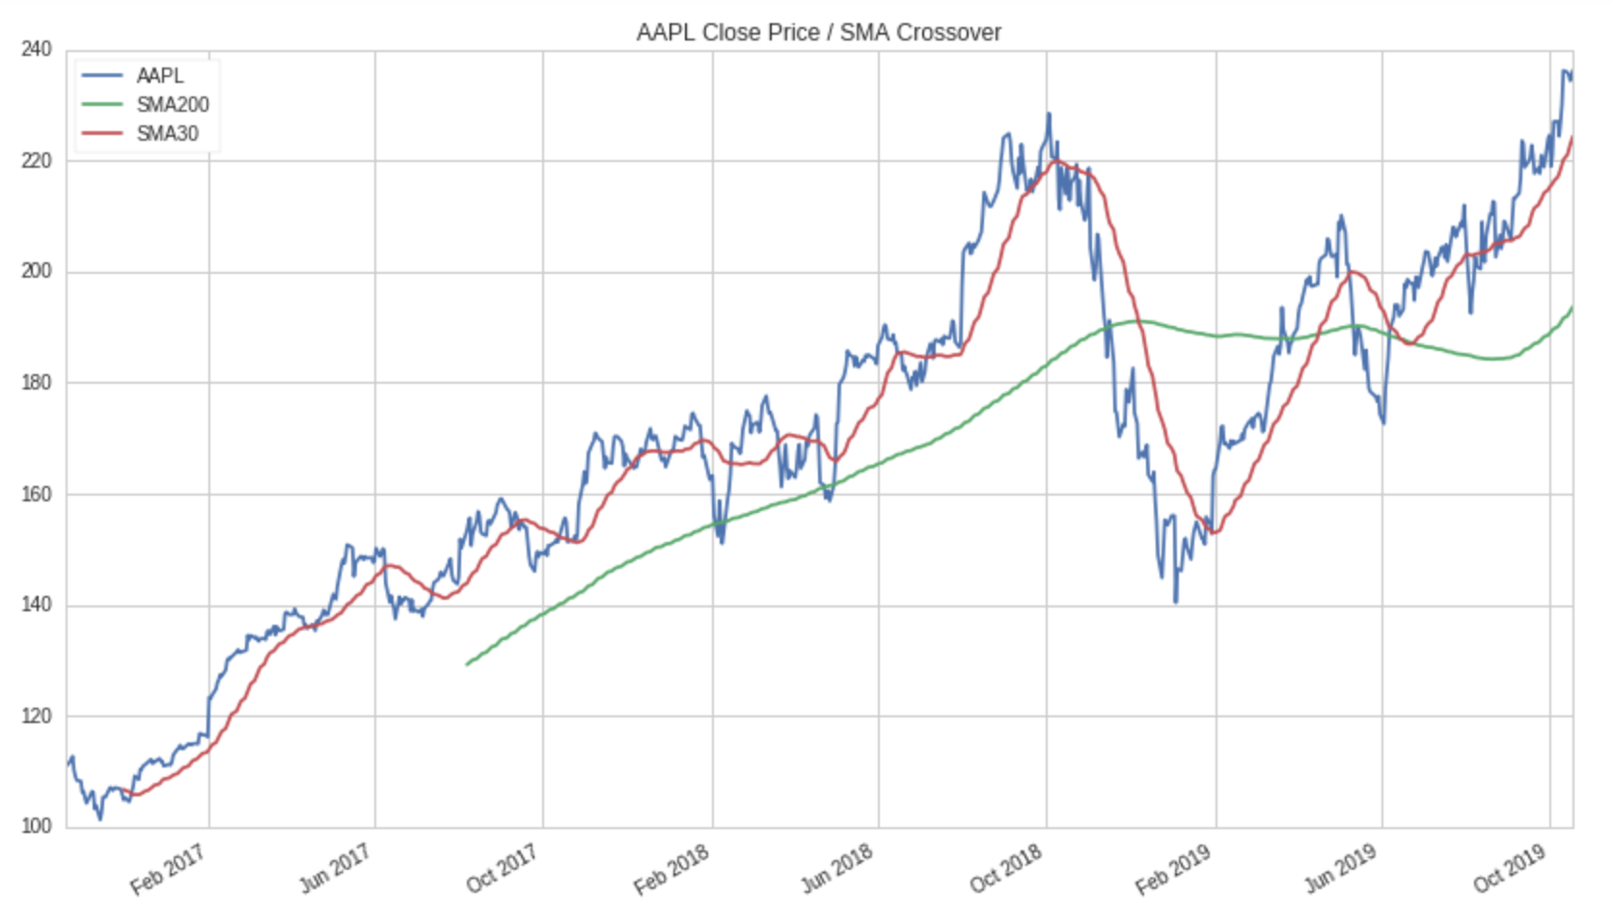

Approach 1: considering momentum effect - Weixiao
Case study: figures
Our approach suggests BUY when red line higher than green line.
(monthly price > 200-day SMA)

Slide 9
Approach 1: considering momentum effect - Weixiao
Case study: figures
Our approach suggests BUY when red line higher than green line.

Slide 10
Approach 1: considering momentum effect - Weixiao
Case study: figures
Our approach suggests BUY when red line higher than green line.
According to what really happened in the history, our suggestion is promising!

Slide 11
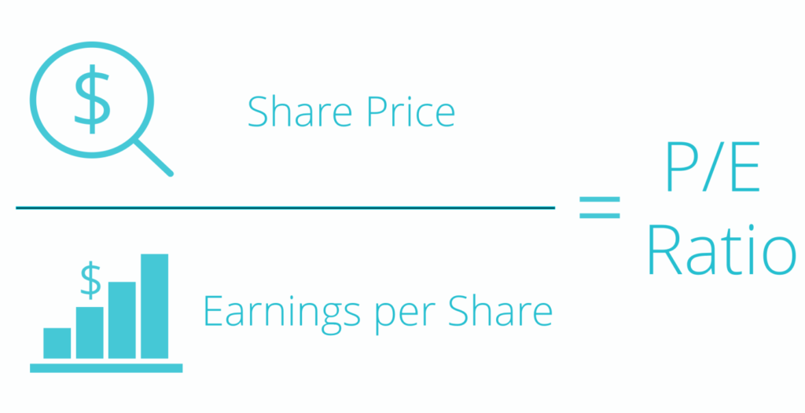
Approach Two
Using Price Per Earning Ratio
Notes:
Jannik

Slide 12





Group by Industry
Notes:
Jannik

Slide 13
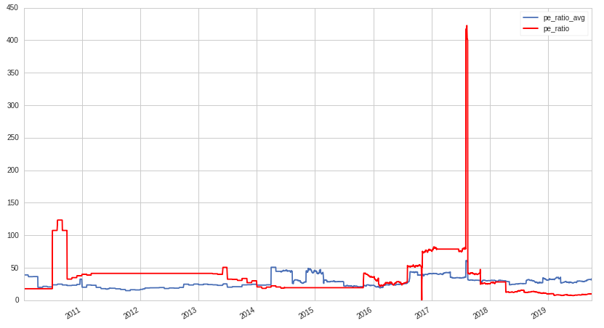
How do we know when to buy?
Find sudden peaks in P/E ratio compared to industry average.
Choose companies with top 3 peaks within a parameter to buy.
Notes:
Jannik

Slide 14
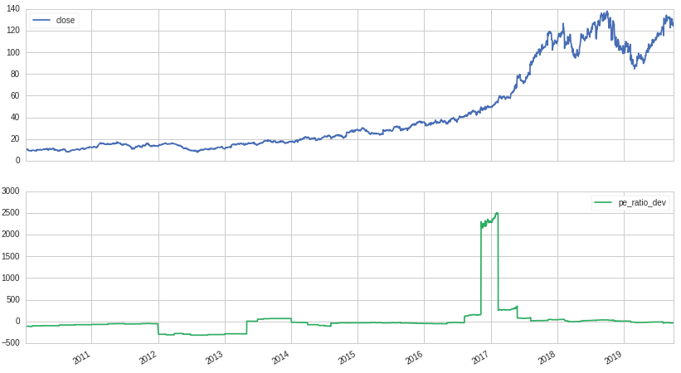
Take-Two Interactive Software
BUY
Notes:
Jannik

Slide 15
Future Improvement
Different groupings
Set specific parameters

Slide 16
Approach Three - Using Mean Reversion
Main Idea
Most of the movement in the market is just noise.
Despite fluctuations, most stocks will remain around their average price.
Calculate a long term (200 day) moving average
Calculate a short term (50 day) moving average
Buy when the short term average is lower than the long term average

Slide 17
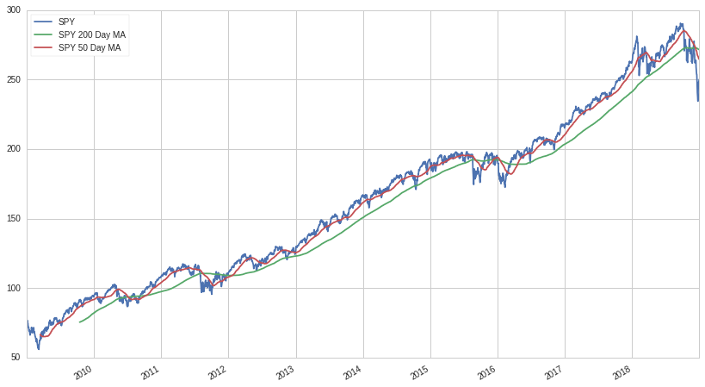
S&P 500
Our approach suggests BUY when red line lower than green line.
Notes:
Jannik

Slide 18
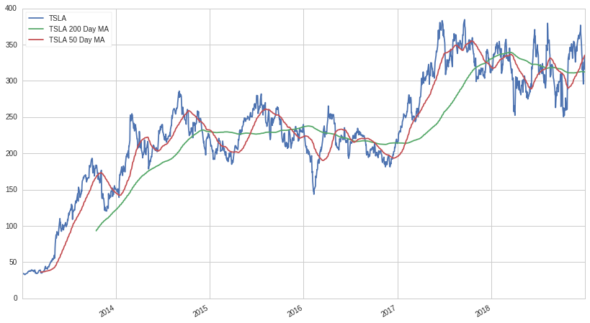
Tesla
Notes:
Jannik

Slide 19
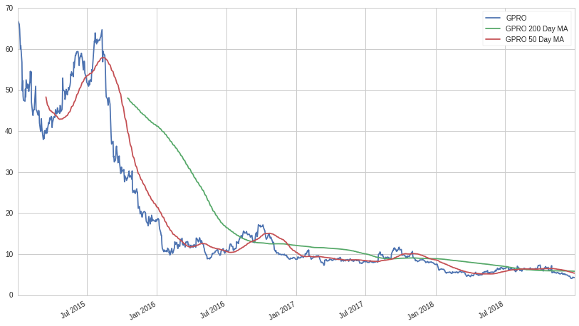
GoPro
Notes:
Jannik

Slide 20
Overview
1. Requires some volatility in securities
Volatility
2. Doesn’t discriminate between meaningless fluctuations and legitimate concerns
3. Needs a strong exit strategy in order to avoid being too greedy or left “holding the bag”
Security
Filtering
Exit Strategy

Slide 21

Approach Four
Using cointegration algorithm
SBUX
DNKN
DQ
Use Top 10 eatery chains’ history data within 2019 to find the Best Pair of stock company
Define [Best Pair] as long-term and short-term stock to do the hedge model training
Use hedge model to find the best time to buy and sell
Price
Volumn
Returns
$120
$90
$210
Notes:
Ysbail

Slide 22
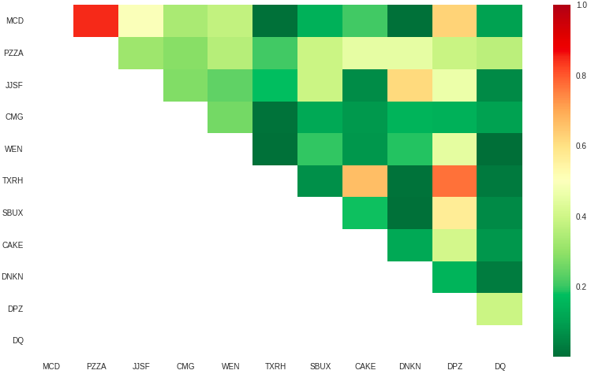
Heatmap
Find the Best Pair
Notes:
This heatmap shows the similarity of the stock trends among the 10 companies we chose. Greener indicates more similar. In this case, we chose [Starbucks] and [Dunkin Donuts] as the [Best Pair] to build our model.

Slide 23
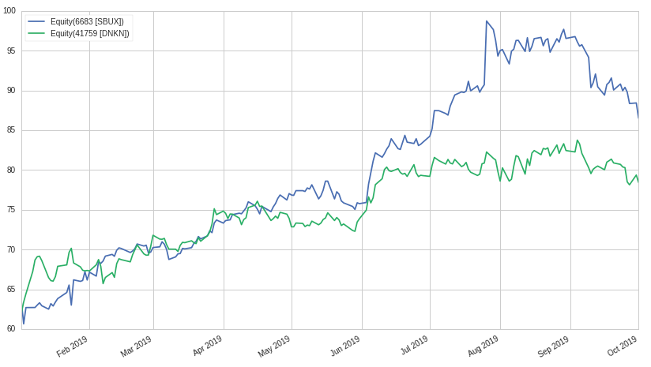
Starbucks - Long term
Dunkin Donuts - Short term
Notes:
This is the stock trends in 2019. Since Starbucks has higher stock price, we will take Starbucks as the long-term stock and the Dunkin Donuts as the short term stock.

Slide 24
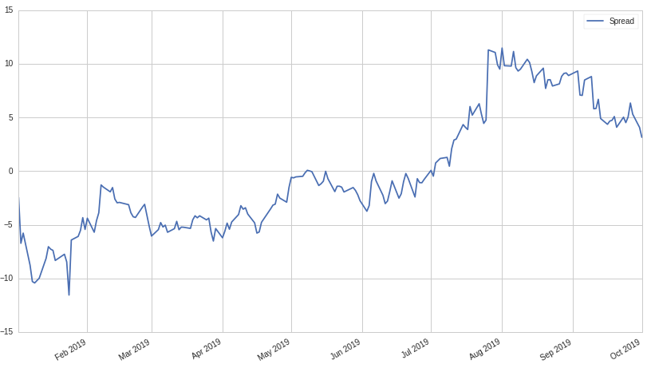
Notes:
There is clear sharp differ in the critical slope chart, which indicates it is the best time to manipulate your in-hand stocks.
Negative slope: Buy short-term sell long-term
Positive slope: Buy long-term sell short-term

Slide 25
Starbucks - Long term
Dunkin Donuts - Short term
Notes:
We can get the same information from the stock trends of Best Pair. When one stock price moves up while the other goes down, that is the best time to buy one and sell the other one in order to maximize the profits earned.
That also proves our hypothesis, for example, this time in January 2019, it is the best time to buy Dunkin Donuts stock and sell the starbucks in hand.

Slide 26

Thank You

